Slide 1
Florida Bright Futures Scholarships
Presenter: Mrs. Gros,
Director of College and Career Counseling
Notes:
Anita

Slide 2
Prayer
Notes:
Anita

Slide 3
Agenda
Intent of the Program = Florida SUS Schools
Slide Reference: www.FloridaStudentFinancialAid.org/SSFAD/bf
General Requirements
Academic Criteria
Application Timeline
Renewal Requirements
Questions
Notes:
Anita

Slide 5
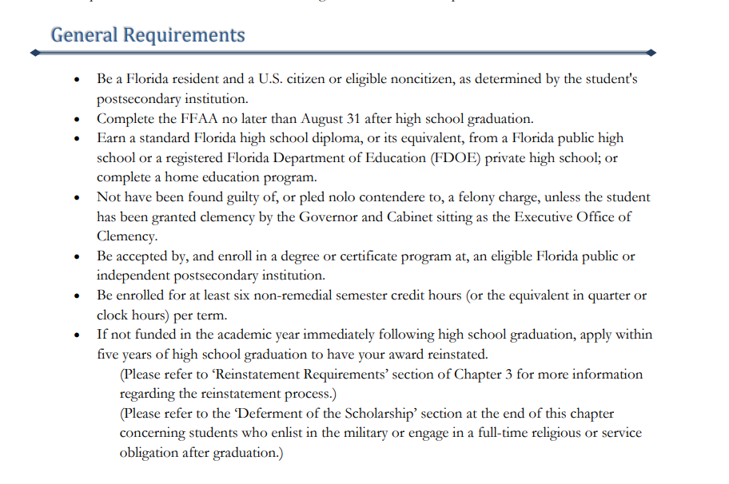

Slide 6
Florida Medallion/Merit Scholars Award
3.0 Bright Futures weighted gpa
1210 SAT or 25 ACT
75 hours of community service
Value as of now =
75% Tuition at 4 year SUS Schools (Approximately $158/credit hour)
100% Tuition at 2 year SUS Schools (Approximately $103/credit hour)

Slide 7
Florida Academic Scholars Award
3.5 Bright Futures weighted gpa
1330 SAT (1340 for Class of 2024) or 29 ACT
100 hours of community service
Value as of now = Full Tuition at SUS Schools
(Approximately $211/credit hour)

Slide 8
Tuition does NOT equal total Cost of Attendance
Cost of Attendance includes:
Tuition
Fees
Room-housing
Board-food
Transportation-flights, cars, parking
Expenses-books, computer, phone, medical insurance, parking
Bright Futures addresses Tuition expenses
Other fees are considered each year when the Legislature meets to include funding of summer classes.

Slide 9
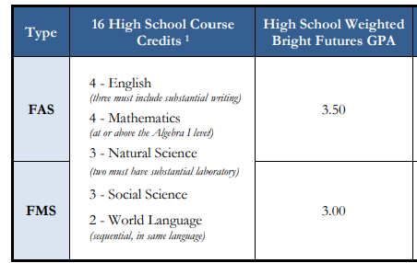
GPA Calculations

Slide 10
SAT/ACT Scores
All scores that used for Bright Futures consideration must be sent directly to a school in the Florida State University System (SUS).
Student name, birthdate, social security number, and address must be exactly the same on the online application, test registration, and Authorization form for the scores to MATCH in the Bright Futures system.

Slide 11
Who should apply?
Any student who is eligible!
If you plan to go to an out of state school…
If you plan to join the military…

Slide 12
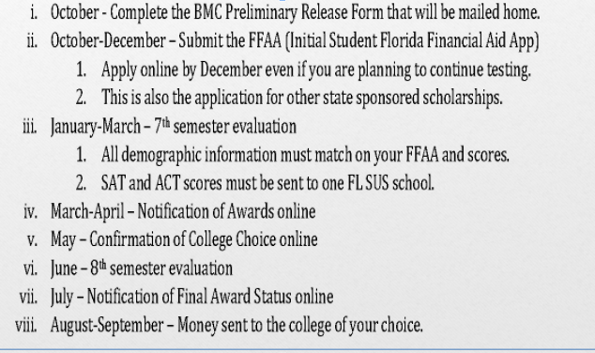
Application Timeline-Senior Year

Slide 13
GPA Renewal Requirements

Slide 14
Bright Futures Contact Information
www.FloridaStudentFinancialAid.org/SSFAD/bf
Toll Free Number: 1-888-827-2004
The Florida Legislature reserves the right to change the program and its requirements at any time.

Slide 15
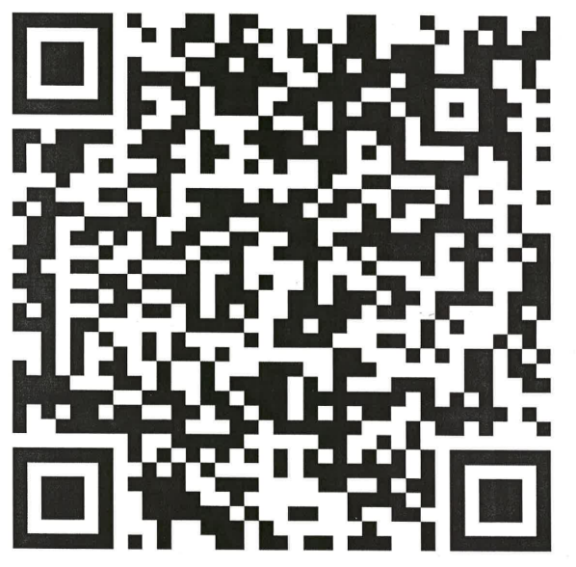
Questions?
Thank you for your time.
Please complete the survey.

